Slide 1



Navigating Tech Trends in the IT Sector
Mélissa-Anaïs Assaf
June 2025

Slide 2


OUTLINE
Executive Summary
Introduction
Methodology
Results
Visualization – Charts
Dashboard
Discussion
Findings & Implications
Conclusion
Appendix

Slide 3

EXECUTIVE SUMMARY
In an ever-evolving technological landscape, staying competitive demands a deep understanding of the most in-demand skills. This report aims to illuminate the dynamic IT industry, analysing current and future trends across programming languages, databases, cloud platforms, and web frameworks.
The insights presented are the result of rigorous data analysis, gathered from diverse and reliable sources, including large-scale surveys (such as Stack Overflow), IBM data, and GitHub job postings. This data has been meticulously aggregated, cleaned, subjected to thorough exploratory analysis, and then synthesized and visualized on interactive dashboards.
Our findings reveal key insights into current technology usage and future demand. For programming languages currently in use, the study shows that JavaScript, SQL, HTML/CSS, are among the most used languages. Looking ahead, those languages most desired for future work include JavaScript, SQL, TypeScript, HTML/CSS, Python, Go, Rust, C#, Bash/Shell, and Java, indicating both continuity and emerging interests.
In the database realm, the most commonly used are PostgreSQL, SQLite, Microsoft SQL Server, MariaDB, Dynamodb, MySQL, MongoDB, Redis, Elasticsearch, and Oracle. As for databases developers want to work with, PostgreSQL, SQLite, MongoDB, Elasticsearch, Dynamodb, Redis, MySQL, Microsoft SQL Server, MariaDB, and Supabase are most popular, suggesting a growing interest in cloud-native and NoSQL options.
Regarding platforms currently used, Amazon Web Services (AWS), Google Cloud, Microsoft Azure, Digital Ocean, Firebase, Heroku, Hetzner, Netlify, and Vercel lead the adoption. For platforms desired for future work, AWS, Google Cloud, Microsoft Azure, Digital Ocean, Vercel, and Firebase are among the top choices.
Finally, in web frameworks, React, Node.js, Angular, Express, Spring Boot, Vue.js, JQuery, Next.js, ASP.NET Core, and ASP.NET are the most utilized. For web frameworks developers aspire to use, React, Node.js, Angular, Next.js, Svelte, Express, FastAPI, Spring Boot, Vue.js, and ASP.NET Core are at the forefront, showcasing a strong preference for modern, performant frameworks.
Beyond technical skills, the study also examines the demographic profile of professionals in the sector. The age distribution highlights that 25-34 year olds constitute the largest group (41.3%). The majority of survey respondents are male, primarily from the United States, which represents the largest respondent group (8,629 respondents), followed by India (3,441 respondents). In terms of formal education, the highest number of respondents hold a Bachelor's degree (8,629). The average age of respondents is 28 years.
By anticipating market evolutions and emerging skills, this report offers key strategic guidance to IT professionals and organizations, empowering them to make informed decisions and proactively plan their skill development initiatives.

Slide 4

INTRODUCTION
This report explores the continuously evolving landscape of the information technology sector, offering valuable insights into the most in-demand skills and technologies. It relies on rigorous data analysis to highlight current and future trends concerning programming languages, databases, platforms, and web frameworks.
The information presented is derived from meticulous data collection from diverse sources, including job postings and specialized surveys.
This work aims to answer fundamental questions such as the current demand for programming languages and database skills, as well as the identification of popular web frameworks.
Specifically designed for IT professionals, HR managers, and anyone eager to understand essential technological skills today and in the future, this document serves as a strategic resource.
It provides readers with a deep understanding of current market dynamics and future projections, thereby equipping them for personal and professional development in this rapidly evolving sector.

Slide 5

METHODOLOGY
This research employed a multi-faceted approach to gather, process, and analyse data, culminating in a comprehensive understanding of IT industry trends.
Data Acquisition: Information was meticulously collected from various sources, including job availability data from diverse locations and technologies, obtained primarily through Python's GitHub Jobs API. This process was further enhanced by scraping pertinent details from the IBM website and downloading datasets from the 2019 Stack Overflow Developer Survey.
Data Preparation (Wrangling): Raw data underwent a series of critical preparation steps. This involved identifying and eliminating duplicate records, assessing and addressing missing values, analysing the distribution of employment status, and normalizing key numerical data points using both Min-Max and Z-score standardization methods, all executed via Python.
Exploratory Analysis: A thorough exploratory data analysis was conducted to understand the underlying patterns. This phase included generating distribution curves and histograms, computing median values and identifying outliers within columns, and calculating interquartile ranges. Furthermore, correlations between various numerical attributes were investigated, and a refined dataset was constructed to facilitate deeper analysis.
Visual Representation: The processed data was translated into compelling visual narratives. A diverse array of chart types was utilized, encompassing histograms, scatter plots, bubble plots, box plots, pie charts, bar charts, and stacked charts. These visualizations effectively showcased data distributions, relationships, and key counts inherent in the dataset.
Dashboard Development: The insights were integrated into interactive dashboards. Specifically, three distinct tabs were developed within IBM Cognos Analytics, focusing on current technology usage, future technology trends, and comprehensive demographic information. All analytical processes, including data cleaning and visualization, were performed using Python within a Jupyter Notebook environment with final dashboard visualizations rendered in Cognos Analytics.

Slide 6
Results

Slide 7
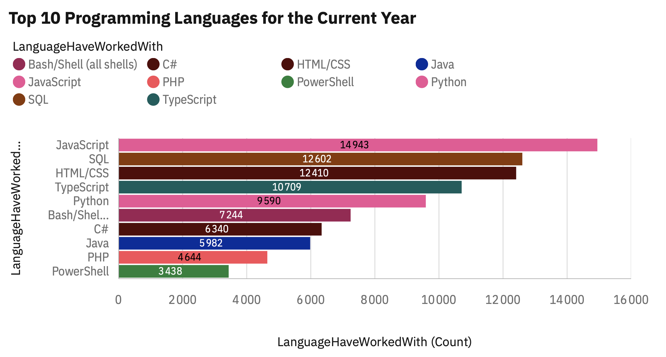
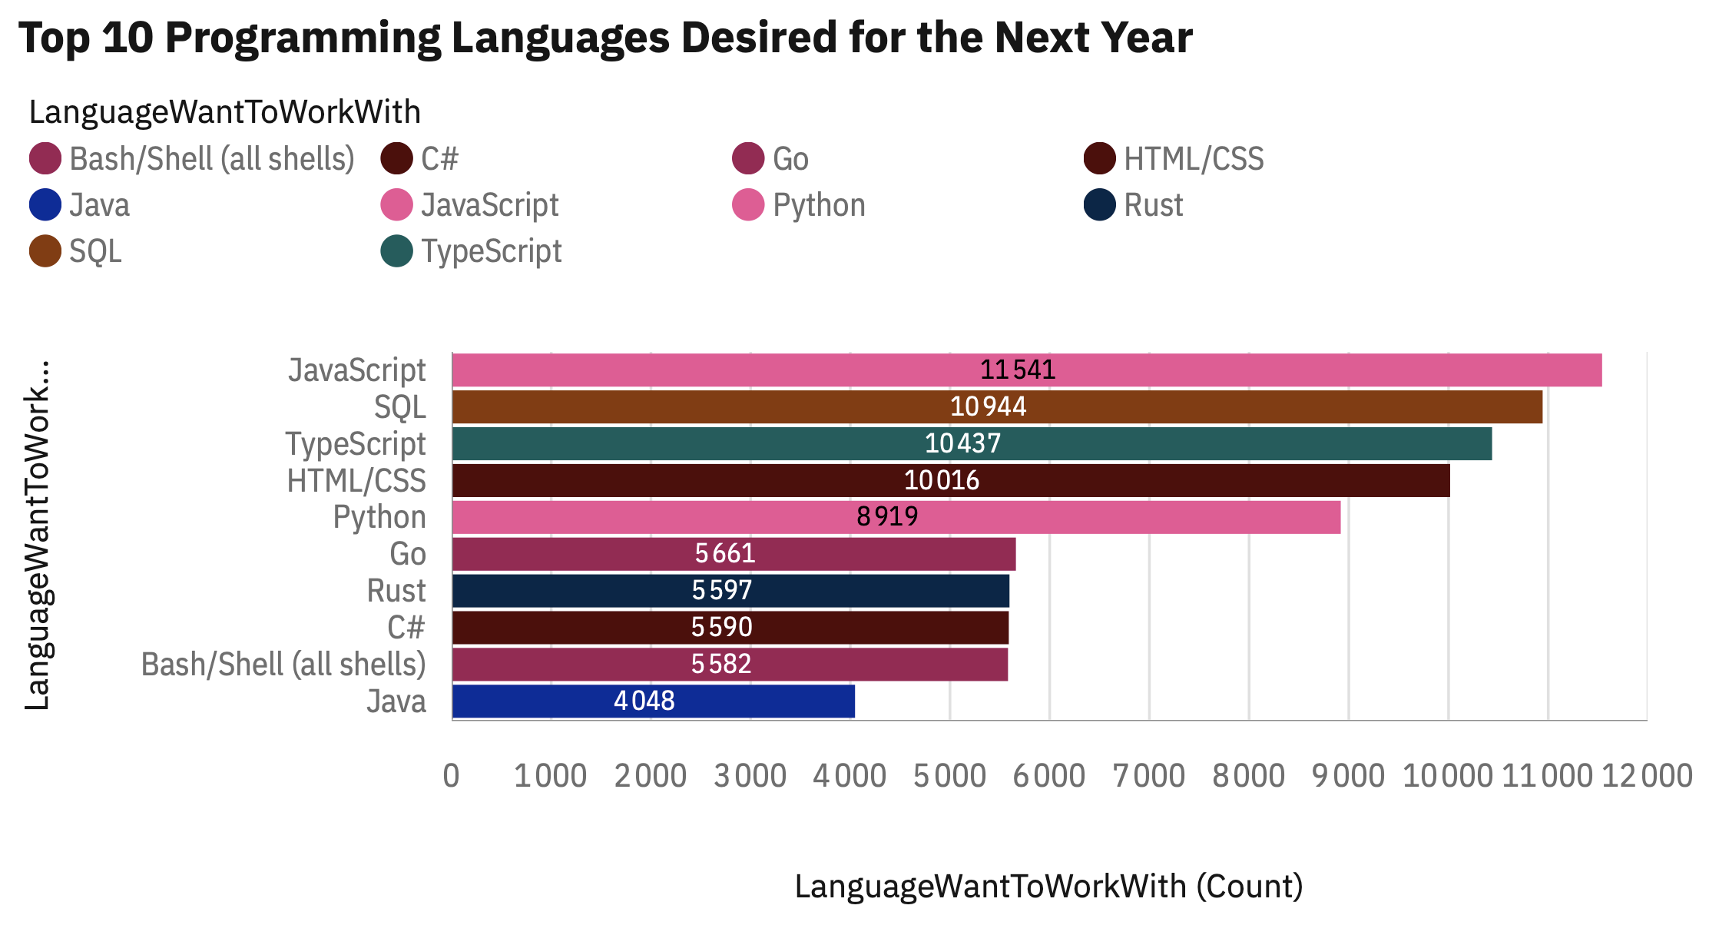
PROGRAMMING LANGUAGE TRENDS
Current Year
Next Year

Slide 8
PROGRAMMING LANGUAGE TRENDS - FINDINGS & IMPLICATIONS
Findings
JavaScript, SQL, and HTML/CSS are the top 3 most used programming languages currently.
JavaScript, SQL, and TypeScript are the top 3 most desired programming languages for the next year.
Languages like Go and Rust, while not in the top current usage, show significant growth in desired future use.
Implications
Professionals should prioritize mastering JavaScript, SQL, and HTML/CSS for current job market relevance.
For future-proofing careers, focusing on JavaScript, SQL, and TypeScript is crucial, indicating sustained demand.
Investing in learning Go and Rust could provide a competitive edge as these languages are rapidly gaining traction in developer interest.

Slide 9
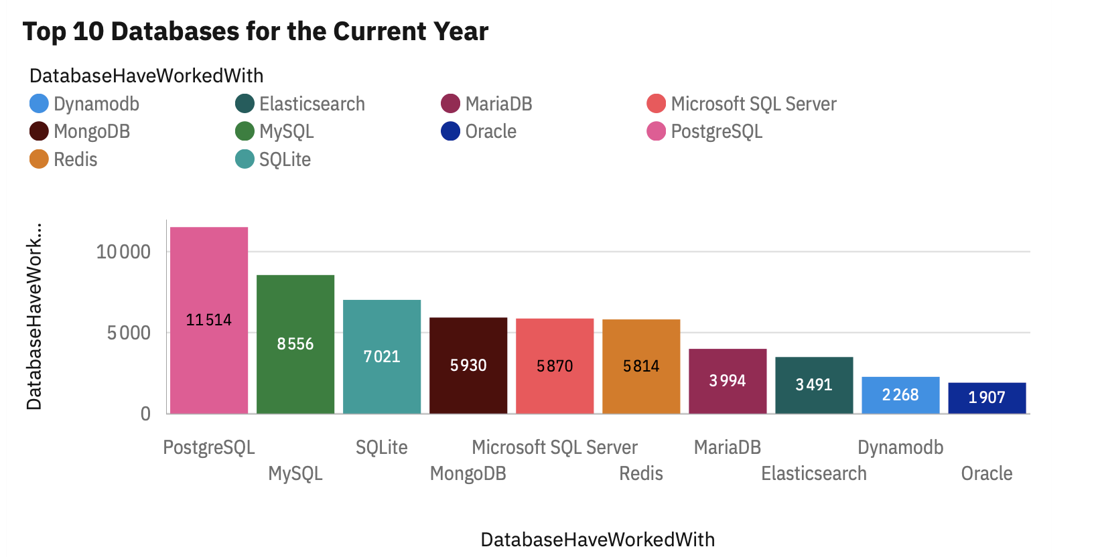
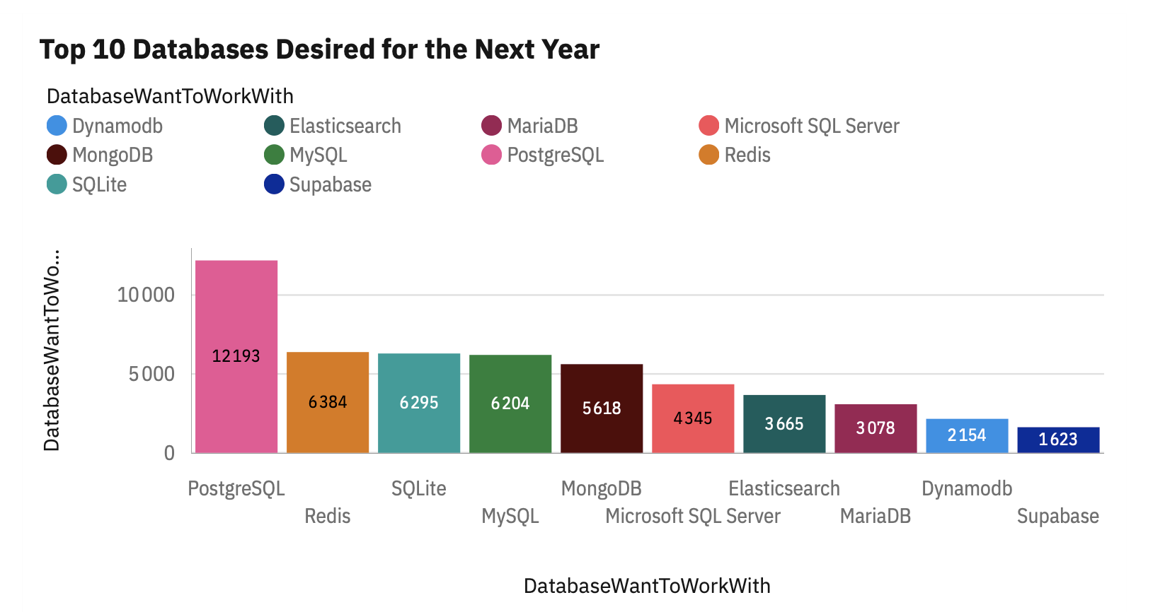
Database TRENDS
Current Year
Next Year

Slide 10
DATABASE TRENDS - FINDINGS & IMPLICATIONS
Findings
PostgreSQL (11,514), SQLite (8,556), and MongoDB (7,021) are the most used databases currently.
PostgreSQL (12,193), Redis (6,384), and SQLite (6,295) are the most desired databases for the next year.
Supabase, while not among the top current usage, shows emerging interest for future use.
Implications
Familiarity with PostgreSQL, SQLite, and MongoDB is essential for current database roles.
Professionals should focus on PostgreSQL and Redis for future career growth in the database landscape.
Exploring newer database technologies like Supabase could offer a competitive advantage.

Slide 11
dashboards

Slide 12
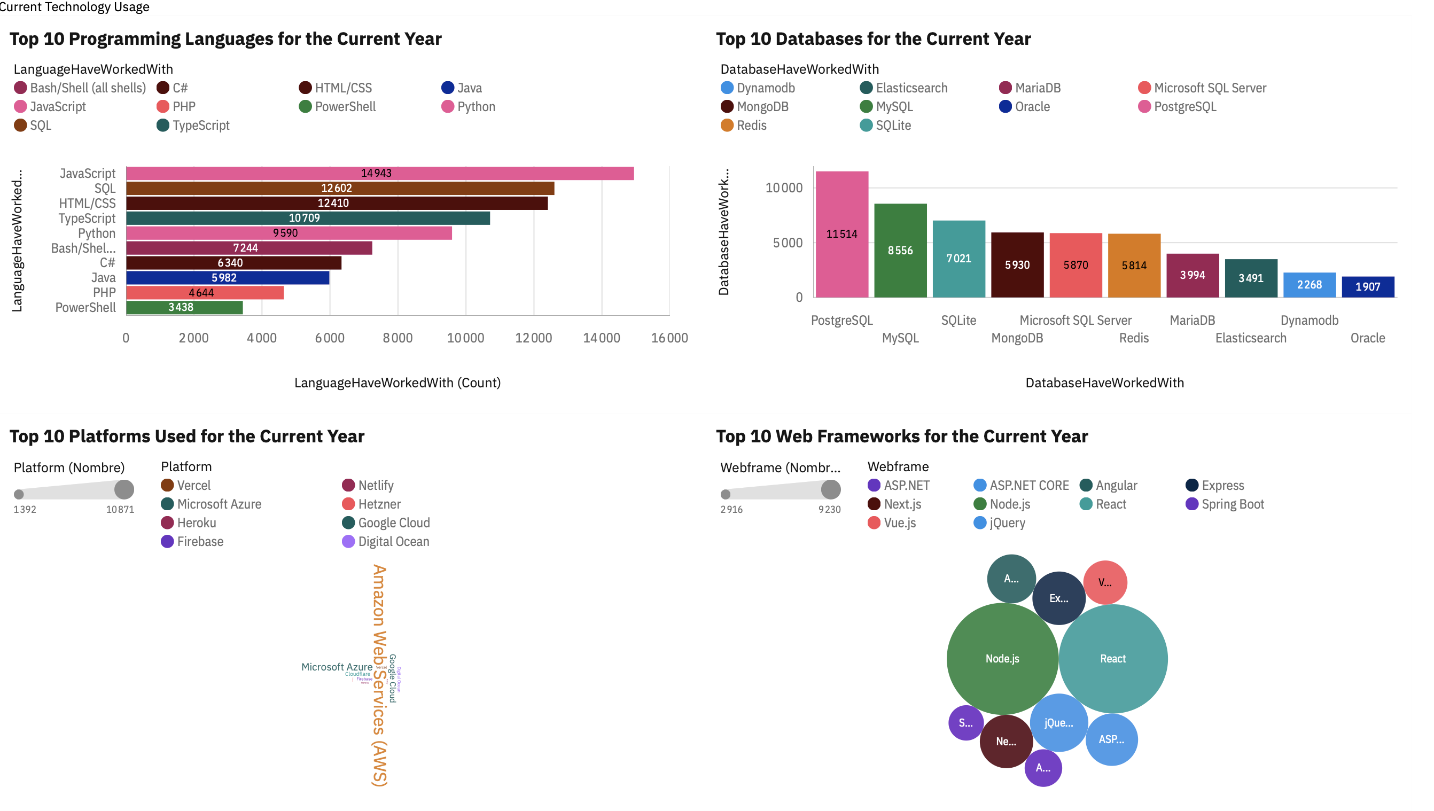

Slide 13
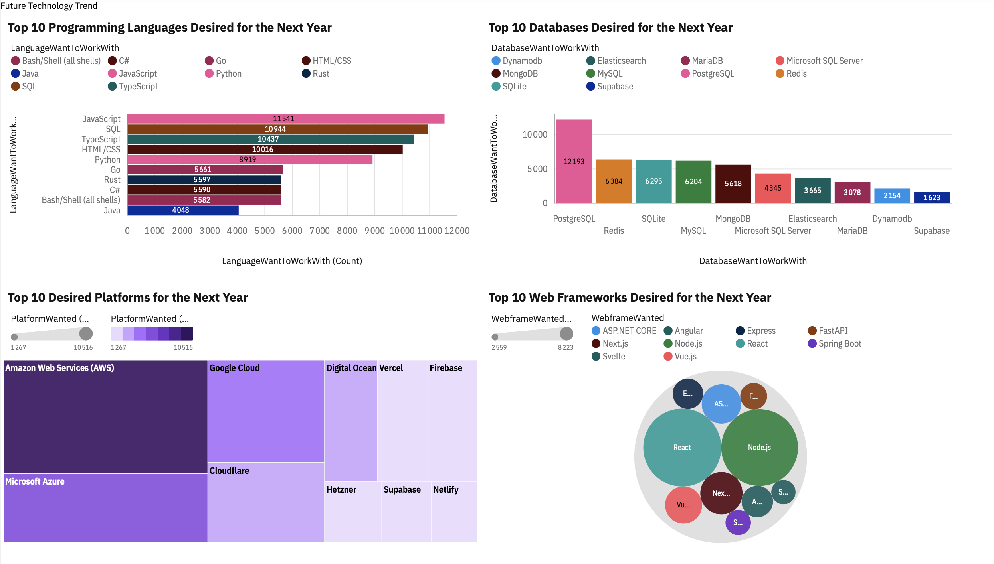

Slide 14
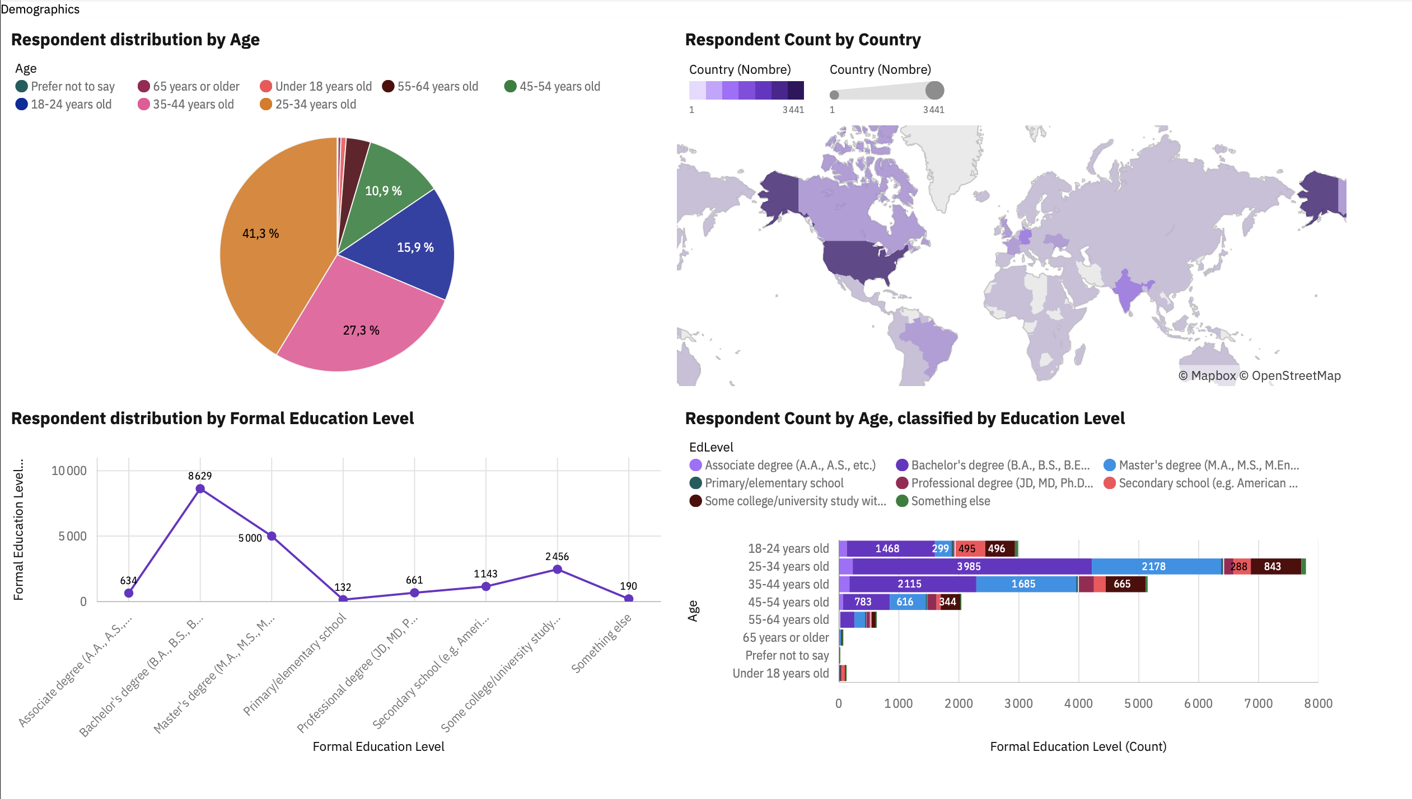

Slide 15

DISCUSSION
Based on the analysis of technology trends and demographic data presented in this report, several key discussion points emerge for IT professionals and organizations:
Adapting to Evolving Skill Demands: Given the strong desire for emerging languages like Go and Rust, and frameworks such as Svelte and FastAPI, how can professionals effectively upskill to meet these future demands and maintain career relevance?
The Future of Established Technologies: What strategies should be considered for technologies like Oracle (databases) and PHP (languages), which show less future interest compared to their current usage? How will their relevance shift in the coming years?
Addressing the Talent Gap & Diversity: With a predominant demographic identified (male, US/India-centric), how can the IT sector foster greater gender diversity and expand access to tech education and development in underrepresented regions globally to broaden the talent pool?
Balancing Formal Education and Practical Experience: While Bachelor's and Master's degrees are common, how critical is continuous practical learning and adaptation to new technologies in driving career progression and job satisfaction, especially considering the rapid pace of change?
Optimizing Work Environments: How can organizations leverage insights into desired platforms (e.g., strong cloud preference) and collaboration tools to create work environments that attract, retain, and empower top tech talent?
The Role of Mobile Development: Given the increasing demand for certain languages and frameworks often associated with mobile (though not explicitly detailed in the provided language trends here, it's a common industry theme), what is the specific outlook and strategic importance of mobile development skills for the future?

Slide 16
OVERALL FINDINGS & IMPLICATIONS
Findings
JavaScript is the most used and most desired language, indicating its continued dominance, while languages like Go and Rust show significant growth in future interest.
PostgreSQL and SQLite are currently widely used databases with rapidly increasing future demand, signalling a shift towards more modern and cloud-native solutions.
AWS, Google Cloud, and Microsoft Azure are the dominant platforms, and React and Node.js are the most dominant web frameworks currently and for the future, confirming the importance of cloud and modern front-end/back-end technologies.
The majority of professionals are young (25-34 years old), hold a Bachelor's or Master's degree, and are predominantly male, concentrated in the United States and India.
Implications
Professionals must continuously update their skills with key technologies like JavaScript and actively explore emerging languages (e.g., Go, Rust) to remain relevant.
Organizations should invest in skills and infrastructure based on PostgreSQL and cloud solutions, anticipating the growing demand for these technologies.
Proficiency in cloud platforms (AWS, Azure, Google Cloud) and frameworks (React, Node.js) is essential for current and future careers and should be a training priority.
Efforts must be made to attract and support greater diversity within the industry and to expand access to technological training in other regions to broaden the talent pool.

Slide 17

CONCLUSION
Continuous Skill Adaptation is Key: The IT landscape demands ongoing learning, with strong current and future relevance in languages like JavaScript, as well as emerging ones like Go and Rust.
Strategic Investment in Modern Tech: Organizations should prioritize investment in PostgreSQL and cloud platforms (AWS, Google Cloud, Azure), along with modern frameworks like React and Node.js, to meet evolving market demands.
Prioritizing Professional Development: Proficiency in dominant cloud and web technologies is crucial for individual career growth and should be a focus for training initiatives.
Fostering Industry Diversity: Expanding efforts to attract and support a broader range of talent from diverse backgrounds and geographical regions is vital for future industry growth and innovation.

Slide 18
Appendices

Slide 19
JOB POSTINGS

Slide 20
POPULAR LANGUAGES

Slide 21
Thank you
Mélissa-Anaïs Assaf
https://github.com/MelissaAnais
https://www.linkedin.com/in/melissaassaf/
IBM Cognos Analytics permanent link
https://eu1.ca.analytics.ibm.com/bi/?perspective=dashboard&pathRef=.my_folders%2FIBM2&action=view&mode=dashboard&subView=model00000197acaff901_00000008

